Slide 1
Database Construction and Knowledge Discovery for Personalized Medicine - Clinical Assessment Aids -
MSc in Genomics & Bioinformatics
By
Ho Ping Chong (Student ID 1155057016)
April 2016

Slide 2
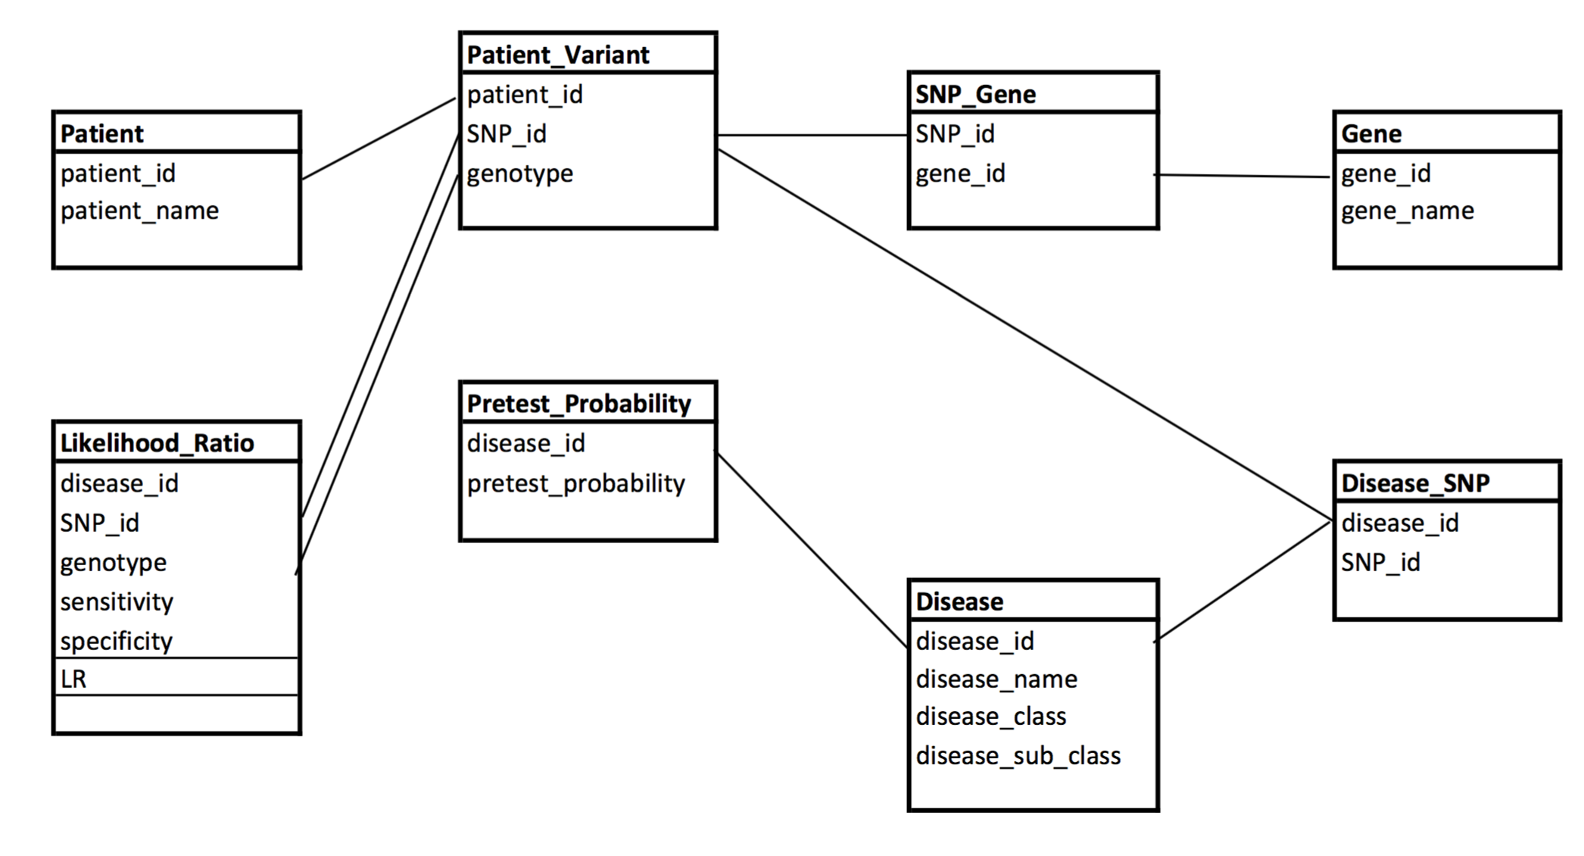

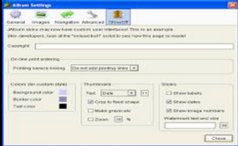
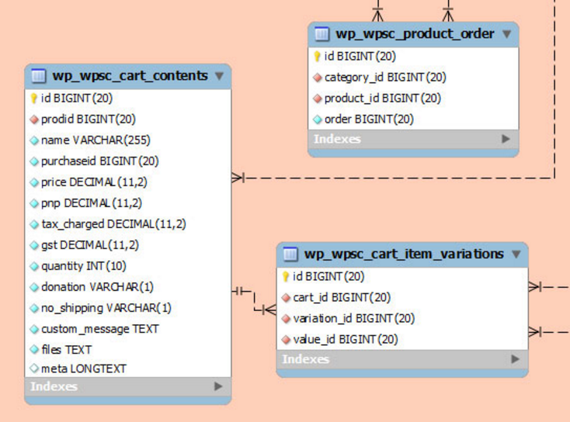
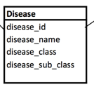
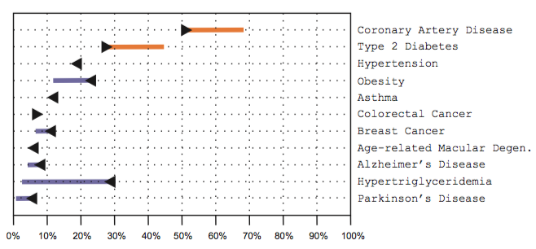
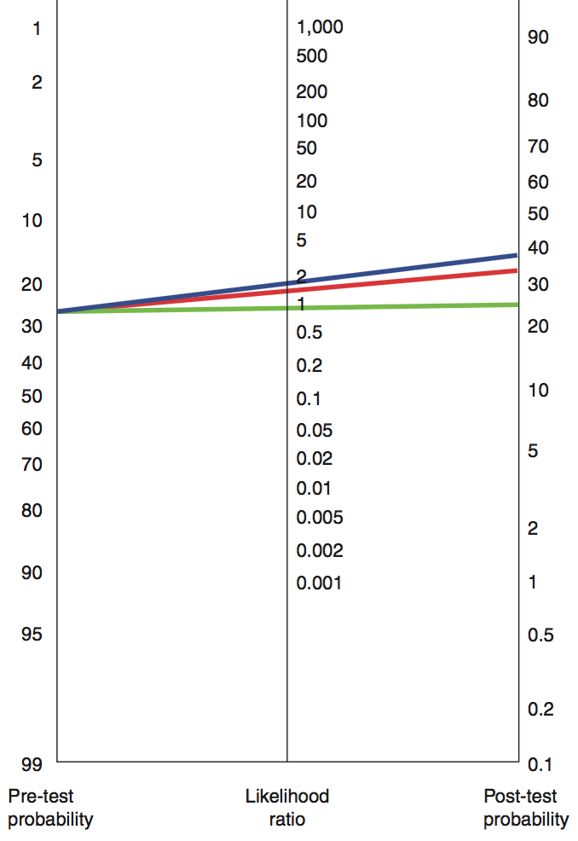

Focus/Effort Allocation
Objective: Design and implement user interface, data visualization and interfacing with data mart.
vcf file
Stored
Procedures
UI
Manual /
Automated
Curation
Stored
Procedures
Database
Stored
Procedures
R Codes
Post-test
Probability
Data Mart
Ken
(Data Acquisition)
Edward
(Database Design)
Tony
(Data Mart Design & Knowledge Discovery)
John
(User Interface & Result)

Slide 3
Agenda
Cloud Based Technology Platform
Workflow
Input, interfacing, presentation, screenshot
Discussion
Evaluation, limitation & difficulty, finding

Slide 4
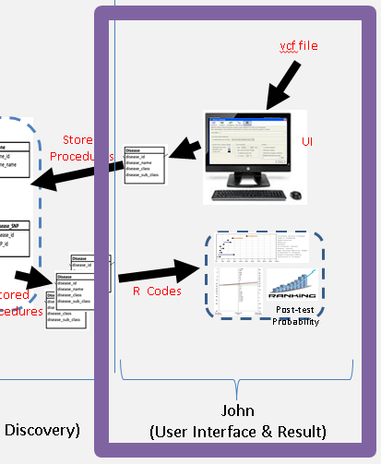
Technology platform
Ubuntu 14.04 LTS 64-bit
MySQL 5.7
R studio
R 3.2.3
Package
Shiny
RMySQL
plotly
vcfR
tidyr

Slide 5
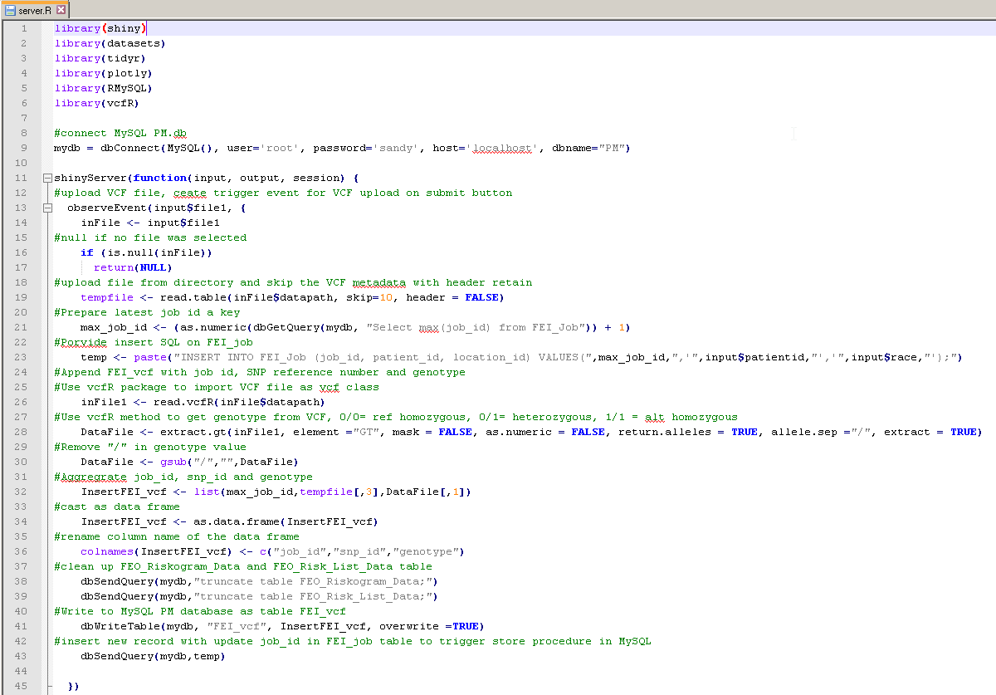
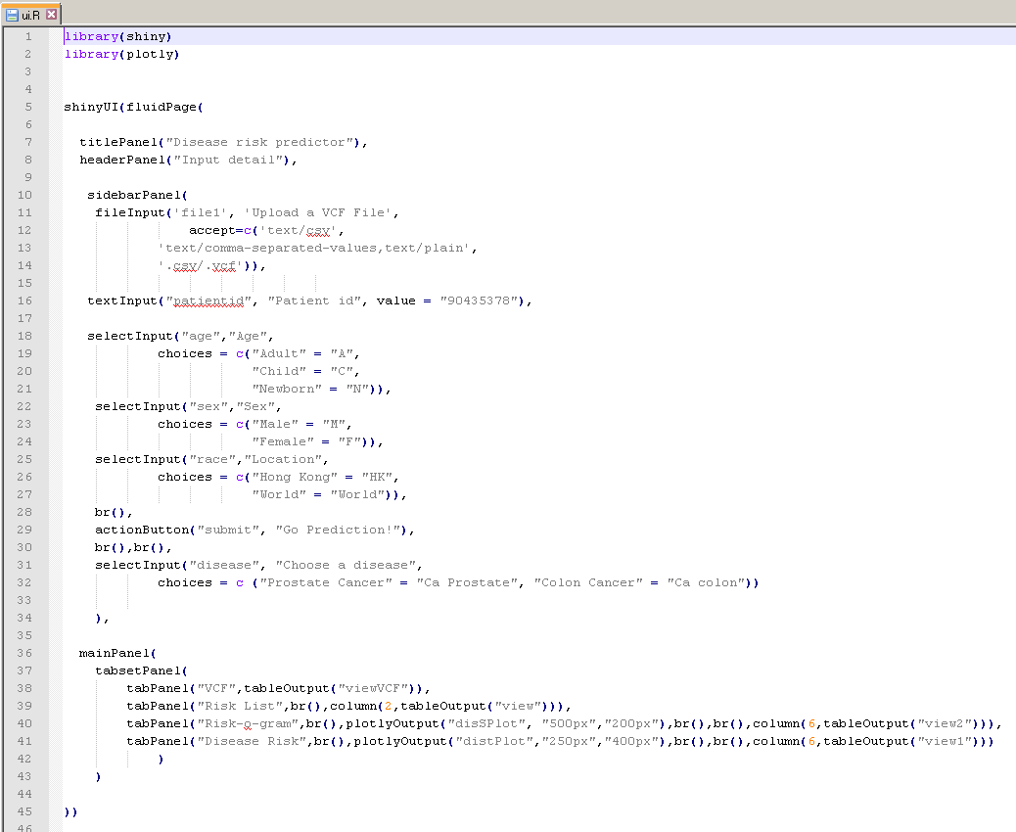
Technology platform
server.R
ui.R

Slide 6
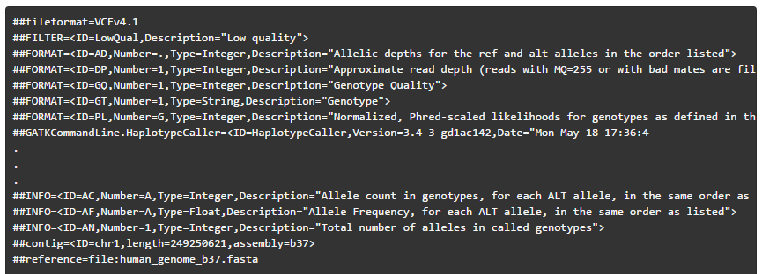
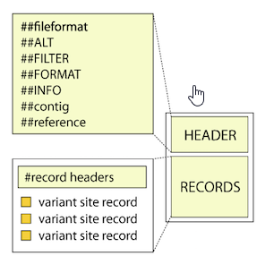
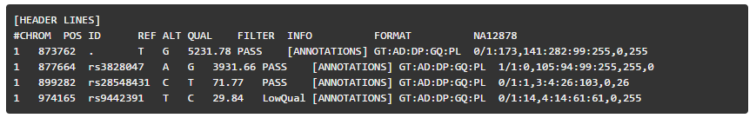
Input - Variant call format (VCF)
Standardized text file format for representing SNP, indel, and structural variation calls

Slide 7
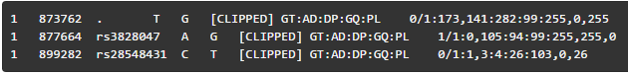
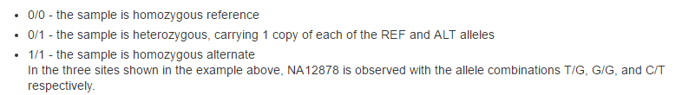
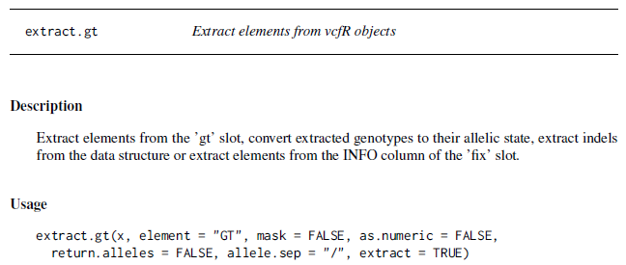
Input – VCF genotype information
Package ‘vcfR’ - Description Tools for working with variant call format ('VCF') files. Reads in 'VCF', 'GFF' and 'FASTA' data for visualization. Includes tools for filtering and writing to 'VCF' files.
Title: Tools for Working with Variant Call Format ('VCF') Files
February 22, 2016
https://cran.r-project.org/web/packages/vcfR/vcfR.pdf

Slide 8
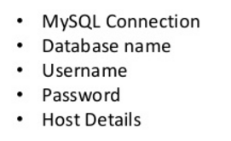
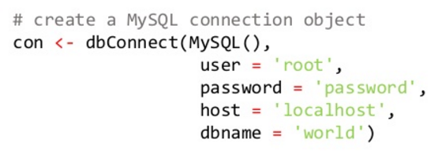
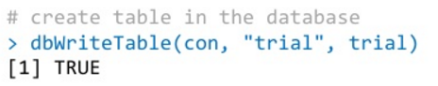
Interface - RMySQL
Title: Database Interface and 'MySQL' Driver for R. January 29, 2016
https://cran.r-project.org/web/packages/RMySQL/RMySQL.pdf

Slide 9
Presentation - Principle
“Clinicians begin with pretest estimates of disease probability and then adjust the probability as new diagnostic information arrives….”
JAMA. 1999 Apr 7;281(13):1214-9
Users' guides to the medical literature: XV. How to use an article about disease probability for differential diagnosis. Evidence-Based Medicine Working Group.

Slide 10
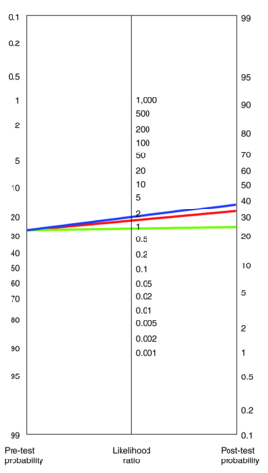
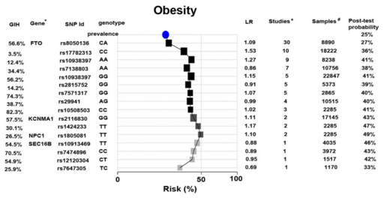

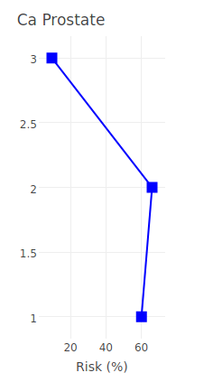
Presentation – data visualization
nomogram
Gupta et al. BMC Genomics 2012, 13:440
Sequencing and analysis of a South Asian-Indian personal genome
Genotype contribution to overall risk
Prostate cancer
Morgan et al. Genome medicine 2010, 2:30
Likelihood ratios for genome medicine
Improving the Prediction of Complex Diseases by Testing for Multiple Disease-Susceptibility Genes

Slide 11
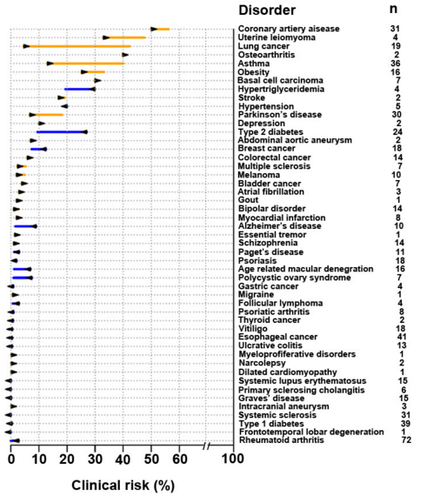
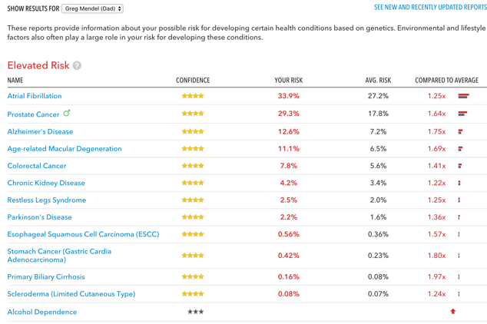
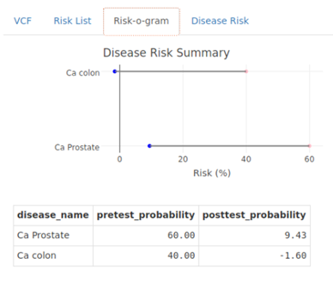
Presentation – data visualization
Gupta et al. BMC Genomics 2012, 13:440
Sequencing and analysis of a South Asian-Indian personal genome
Risk-o-gram
Textual format

Slide 12
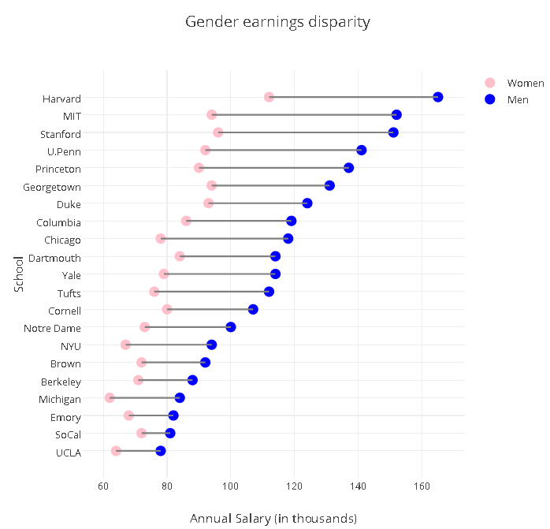
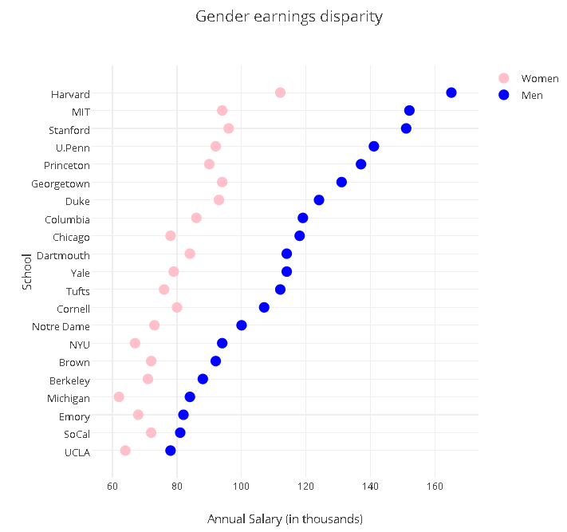
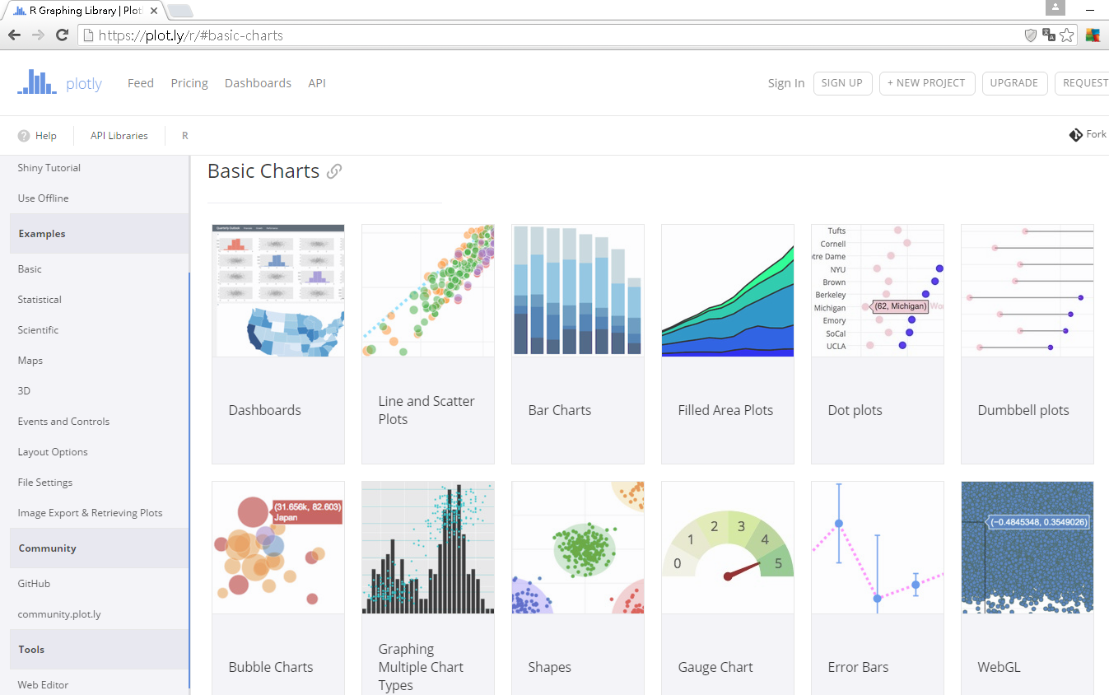
Presentation - Plotly package
Plotly is an R package for creating interactive web-based graphs via the open source JavaScript graphing library plotly.js
https://plot.ly/r/getting-started/#getting-started-with-plotly-for-r

Slide 13

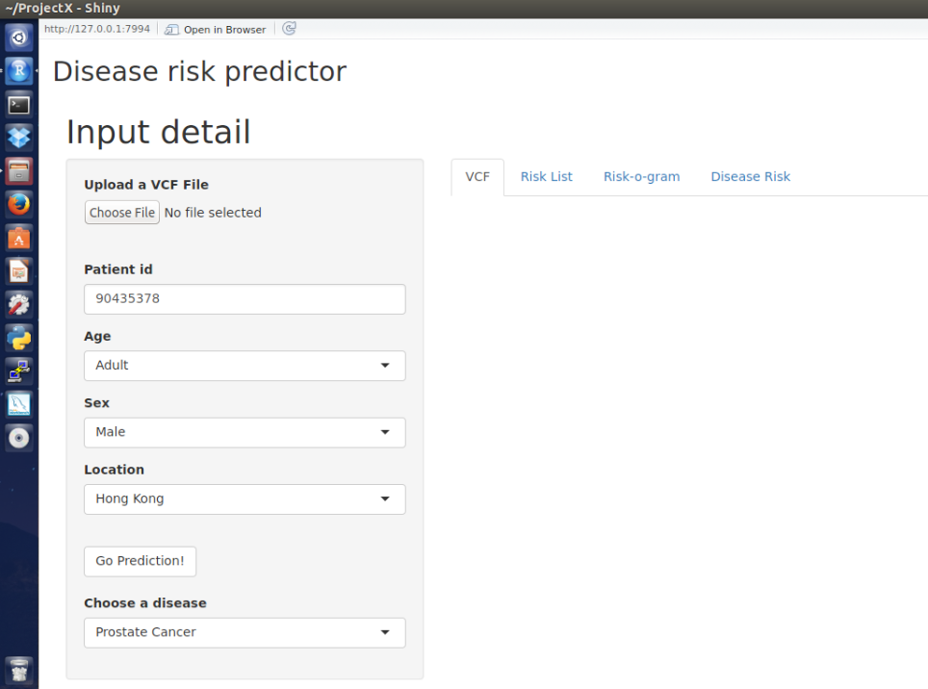
User Interface - screenshot

Slide 14
User Interface - screenshot

Slide 15
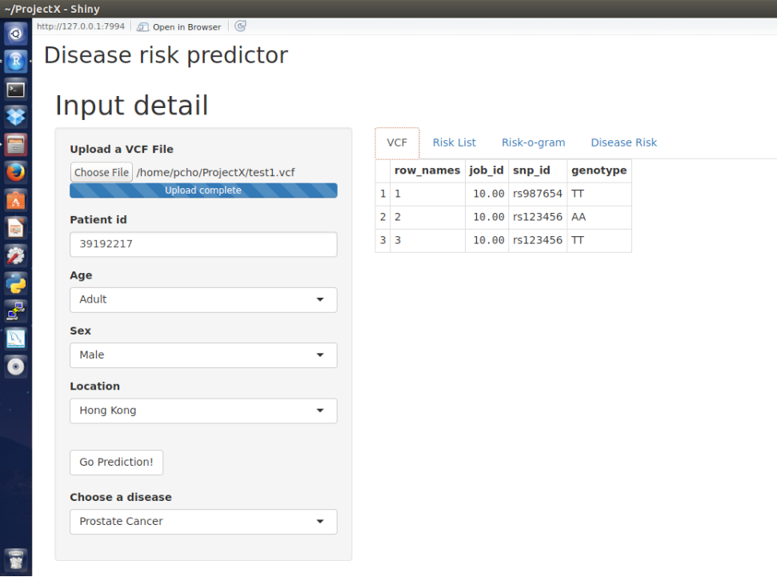
User Interface - screenshot

Slide 16
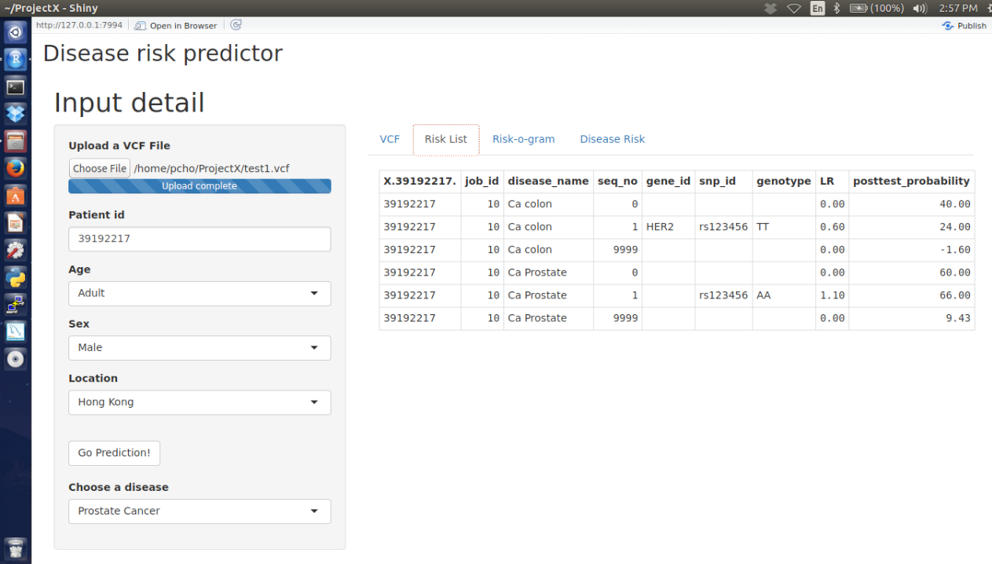
User Interface - screenshot

Slide 17
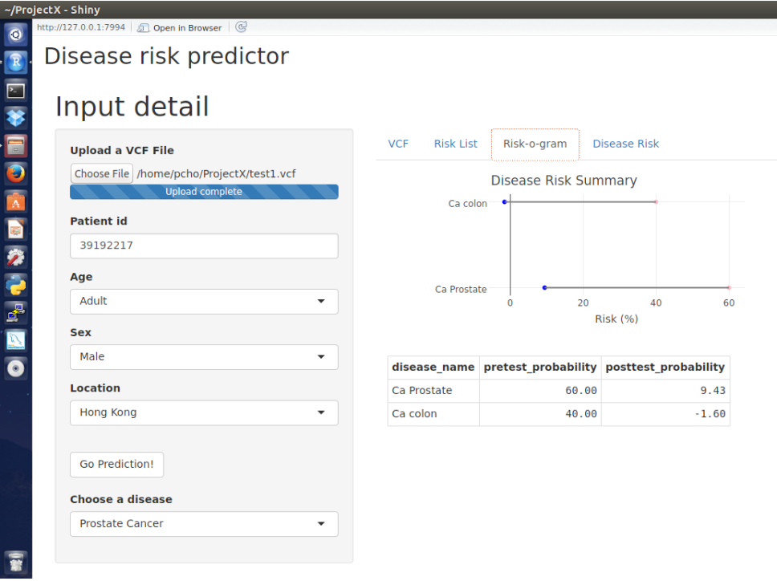
User Interface - screenshot

Slide 18
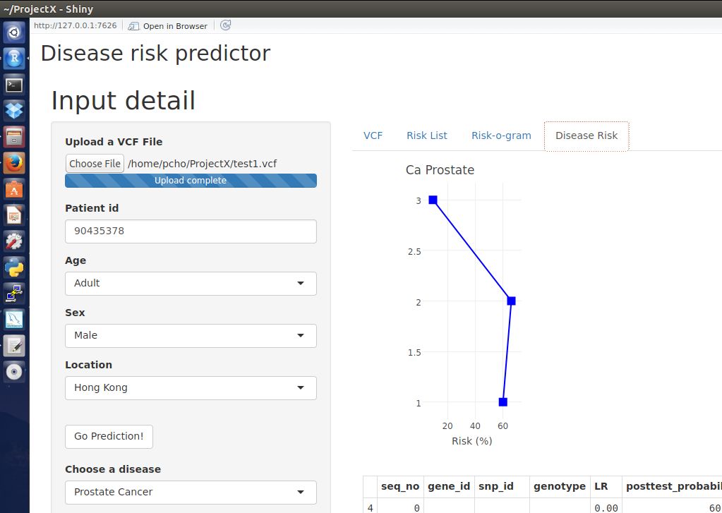
User Interface - screenshot

Slide 19
Evaluation - Approach
Programming logic validation
Synthetic data
System validation
23andMe sample

Slide 20
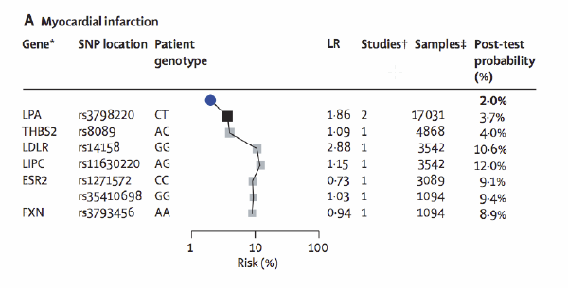
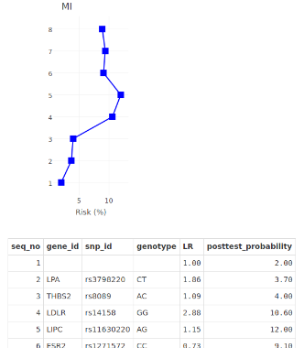
Evaluation – Programming logic validation
http://stanford.edu/class/gene210/files/lectures/2011/4_Salari_AnalyzingGWASData.pdf

Slide 21
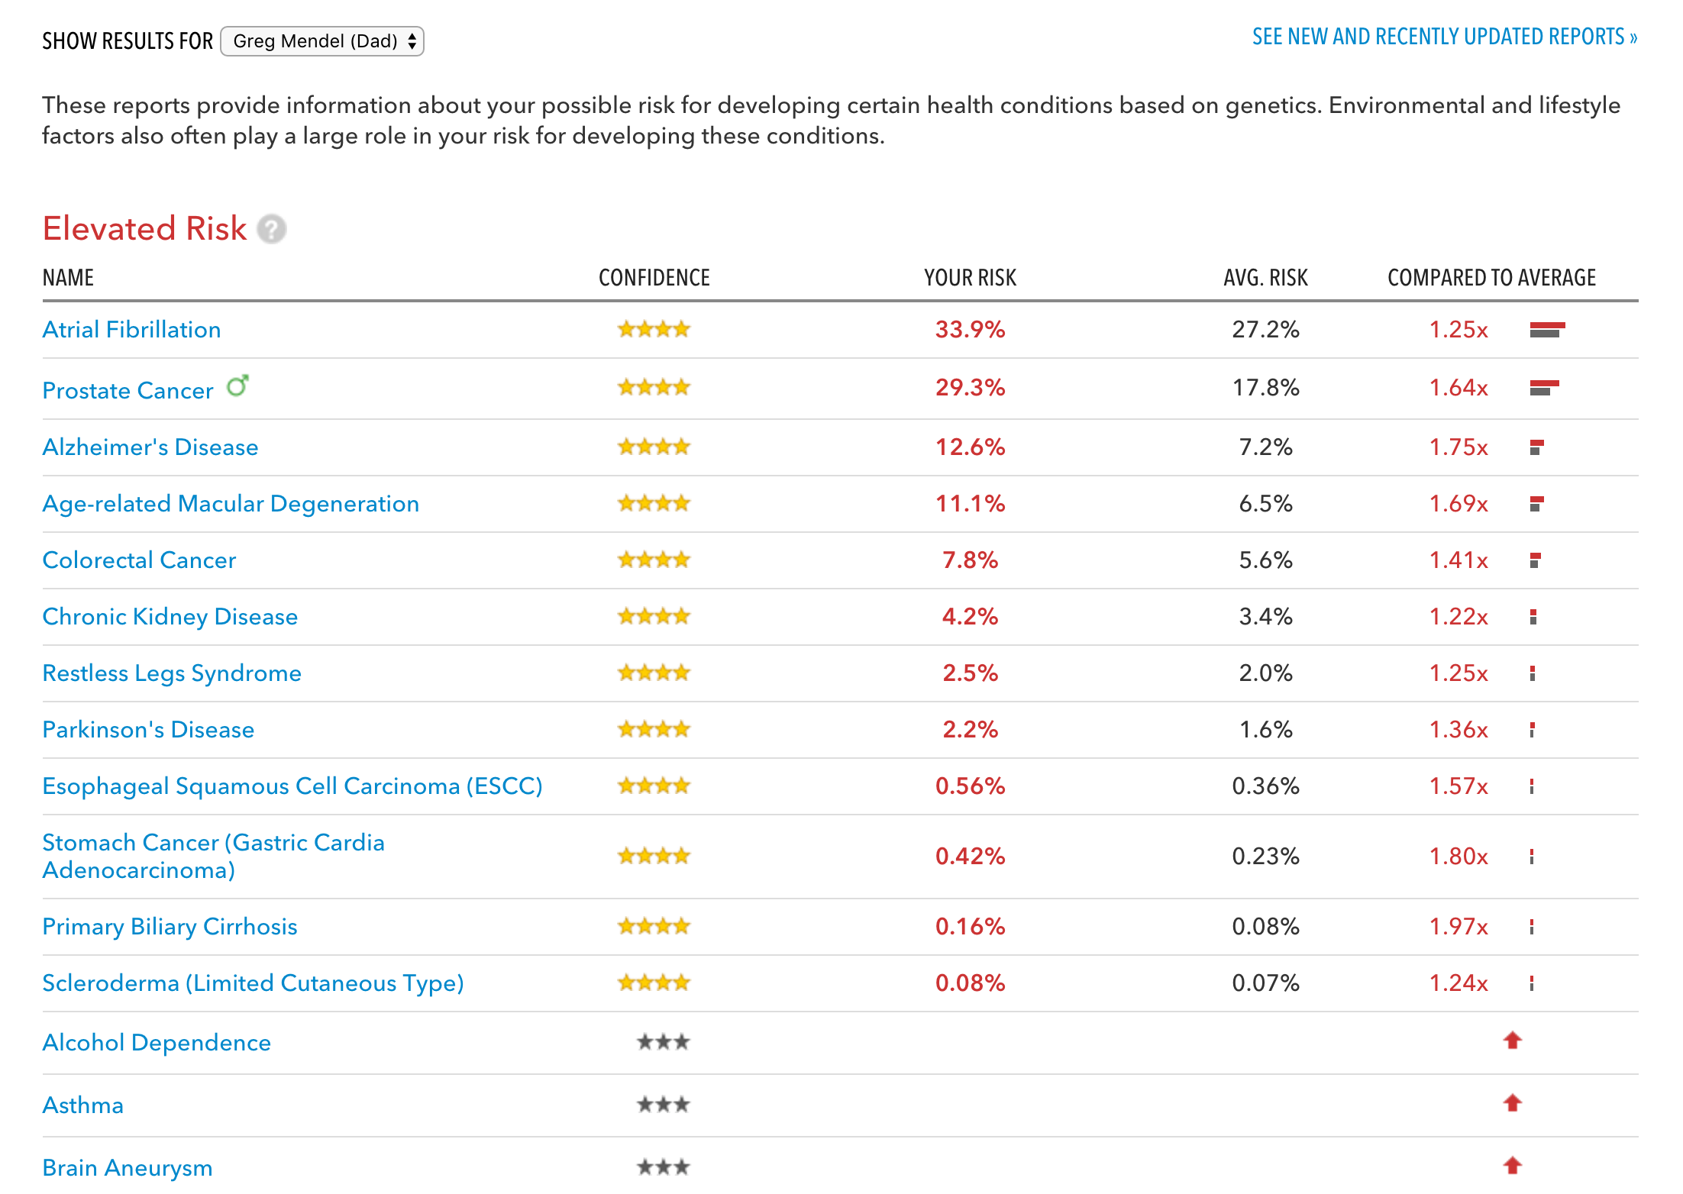
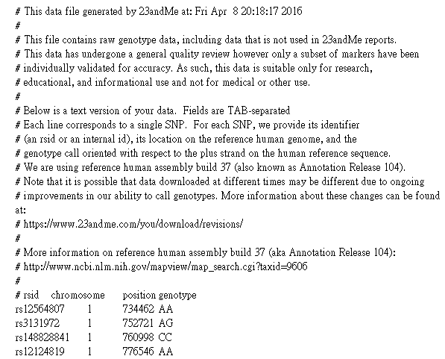
Evaluation – System validation
Genome_Greg_Mendel_Dad_Full_20160408201817 – 598897 snp 1..22, XY, MT

Slide 22
Limitations and difficulty
Difficult to collect likelihood ratio
Limited resource
Incomplete SNP data set which likelihood ratio is available
Limited supply of Literature
Manual curate
Maintenance difficulty, error prone
Alternate metric
Odd ratio

Slide 23

“…likelihood ratios is not being published in the primary publications associating genotype with disease…”
“Traditionally, the published literature on genetic associations has focused on suggesting interesting variants with possible mechanistic involvement in the disease of study. Hence, authors may only report an odd ratio as a measure of effect size, and a P value to show that the variant is significantly associated with that disease”
Morgan et al. Genome Medicine 2010, 2:30 Likelihood ratios for genome medicine

Slide 24
Finding
“..the objective of “personalized genomics” is not necessarily to predict disease with any certainty, but rather to provide another line of evidence that physicians and other medical practitioners can consider in their interactions with patients…”
Patel et al. Genome Medicine 2013, 5:58. Whole genome sequencing in support of wellness and health maintenance

Slide 25


Slide 26
Appendix

Slide 27
R source code – server.R

Slide 28
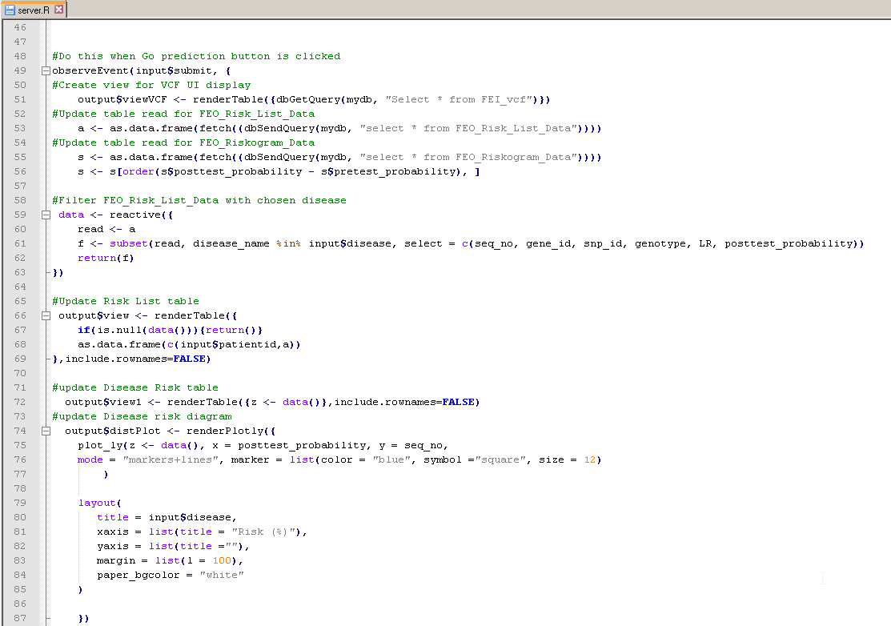
R source code – server.R

Slide 29
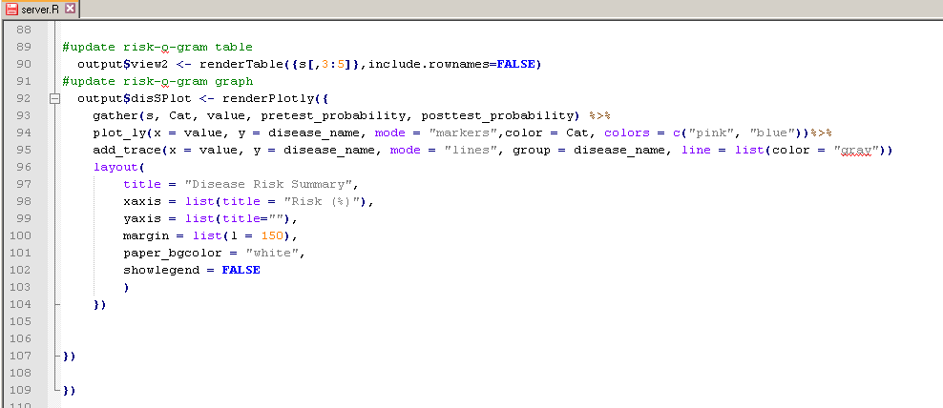
R source code – server.R

Slide 30
R source code – ui.R

Slide 31
Evaluation – 23andMe sample
dbSNP
Disgenet
SNP to trait
Literature support
https://cgsmd.isi.edu/dbsnpq/downloads.php
http://www.disgenet.org/web/DisGeNET/menu/downloads#all
Association type (example) | Count (unique SNP)
Biomarker (rs8008270) | 137 (57)
Biomarker, GeneticVariation (rs1058205) | 110 (31)
GeneticVariation (rs10498792) | 26 (15)

Slide 32
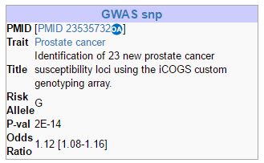
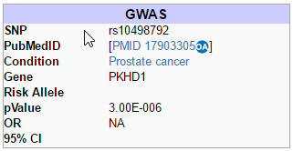
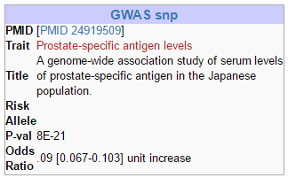
Evaluation - SNPedia
GeneticVariation (rs10498792)
Biomarker (rs8008270)
Biomarker, GeneticVariation (rs1058205)

Slide 33
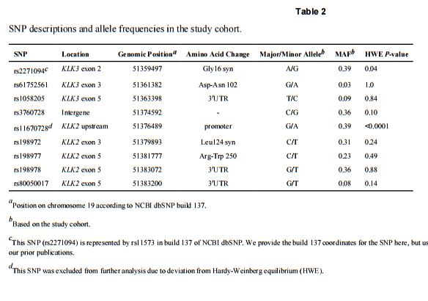

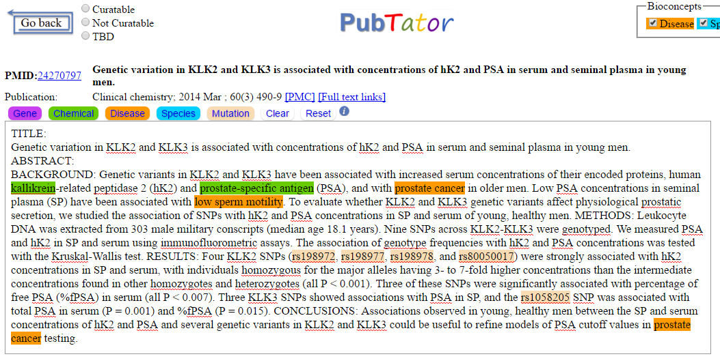
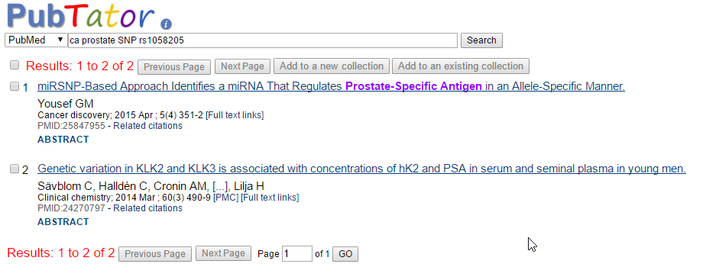
Evaluation – 23andMe sample

Slide 34
Assumptions
Only +ve Pre-test Probability and +ve Likelihood ratio are considered, and to be obtained from external data sources
Prostate Cancer is the first disease use with the research prototype

Slide 35

